Slide 1
Extra C++ Pointer Practice Questions Credit: Ashley and Varick Erickson

Slide 2
Review: Key Pointer Syntax Rules and Tips
Use the reference operator & to get the memory address of a variable.
cout << &num; // prints memory address of numUse the asterisk * when declaring pointer variables
int *ptr1, *ptr2, …;
//declares two pointer variables for int type
//spacing between * and ptr doesn’t matter
You cannot mix different data types with pointers.
Using * and a pointer variable name will allow us to directly access the data the pointer is pointing at.
cout << *ptr1 << endl; //returns value ptr1 is pointing at
Using the assignment operator (=) changes the pointer’s memory address, which changes where our pointer points. This will change the memory address where the pointer points.
Using = and * together directly changes the value that our pointer is pointing to.
Use the new operator to create a new dynamic variable where a pointer points.
Draw pictures when you work with pointers, to help keep track of what is happening.
Memory address
Variable name
value

Slide 3
Pointer Practice Questions
Follow along on paper as we complete these practice questions
These questions are taken directly from past assignments and past exams.

Slide 4
Pointer Practice 1
Find the output for the cout<< statements in the below program.
int* a;
int* b;
int* c = new int;
int luckyNumber = 7;
int mysteryNumber = 10;
c = &mysteryNumber;
a = &luckyNumber;
b = a;
*b = *a + luckyNumber;
a = new int;
*a = *b + *c;
cout << "*a = " << *a << endl;
cout << "*b = " << *b << endl;
cout << "*c = " << *c << endl;
cout << mysteryNumber << endl;

Slide 5
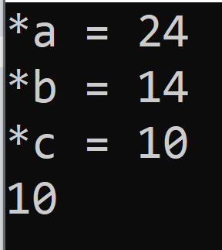
Pointer Practice 1 - solution
int* a;
int* b;
int* c = new int;
int luckyNumber = 7;
int mysteryNumber = 10;
c = &mysteryNumber;
a = &luckyNumber;
b = a;
*b = *a + luckyNumber;
a = new int;
*a = *b + *c;
cout << "*a = " << *a << endl;
cout << "*b = " << *b << endl;
cout << "*c = " << *c << endl;
cout << mysteryNumber << endl;

Slide 6
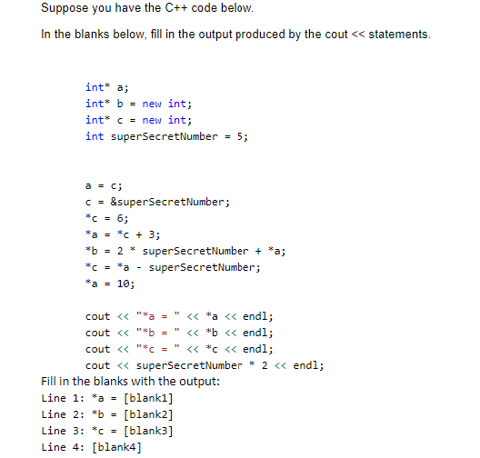
Pointer Practice 2

Slide 7
Pointer Practice 2 - solution
Answer: blank 1 = 10, blank 2 = 21, blank 3 = 3, blank 4 = 6.

Slide 8
Pointer Practice 3
int pointerMath(int x, int& y, int* z)
{
x = 5;
y = *z + x;
(*z)++;
return(x * y);
}
int main()
{
int* a = new int;
int* b = new int;
int* temp = nullptr;
int randomNumber = 5;
*a = randomNumber;
*b = 11;
temp = a;
int answer = pointerMath(*a, randomNumber, temp);
cout << answer << endl;
cout << *a << endl;
cout << *b << endl;
cout << *temp << endl;
return 0;
}

Slide 9

Pointer Practice 3 - solution
int pointerMath(int x, int& y, int* z)
{
x = 5;
y = *z + x;
(*z)++;
return(x * y);
}
int main()
{
int* a = new int;
int* b = new int;
int* temp = nullptr;
int randomNumber = 5;
*a = randomNumber;
*b = 11;
temp = a;
int answer = pointerMath(*a, randomNumber, temp);
cout << answer << endl;
cout << *a << endl;
cout << *b << endl;
cout << *temp << endl;
return 0;
}

Slide 10
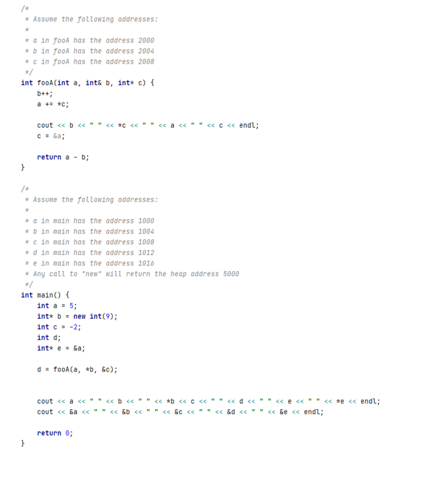

Pointer Practice 4

Slide 11

Pointer Practice 4 Solution

